Slide 1
Data Validation Application
Project Overview
The issue
A critical data integrity issue surfaced—our reports were compromised by missing and inaccurate data, jeopardising the reliability of our insights and our credibility with the client.
In response, a rapid and decisive data validation process was implemented, aligning datasets between the client’s system (Senpiper) and our UK server.
This swift intervention restored data accuracy and safeguarded our business operations and client trust.

Slide 2
Data Validation Application
Project Overview
The solution
⚡ Date Range Confrontation – Cross-checked timelines to confirm that both datasets covered the same periods. Any inconsistency could distort trends and insights.
⚡ Row Count Showdown – Verified that both datasets held the same number of records. Any mismatch could signal data loss or duplication.
⚡ Hunt for Missing Data – Scanned for blank mandatory fields, identifying critical gaps that compromised our reports.
⚡ Column Name Lockdown – Ensured every column matched perfectly between sources—no room for ambiguity or misinterpretation.

Slide 3
Data Validation Application
Project Overview
Benefits & Impact
✅ Crisis Averted – Quick action prevented a major data disaster and potential business losses.
✅ Accurate Data – Ensured clean, consistent, and reliable data for better reporting.
✅ Cross-Department Use – The app can be used in other departments to validate data from various sources.
✅ Faster Decisions – Reliable data enables quicker and smarter decision-making.
✅ Time & Cost Savings – Early detection avoided costly errors and saved troubleshooting time.
✅ Client Trust – Reinforced client confidence through proactive problem-solving.

Slide 4
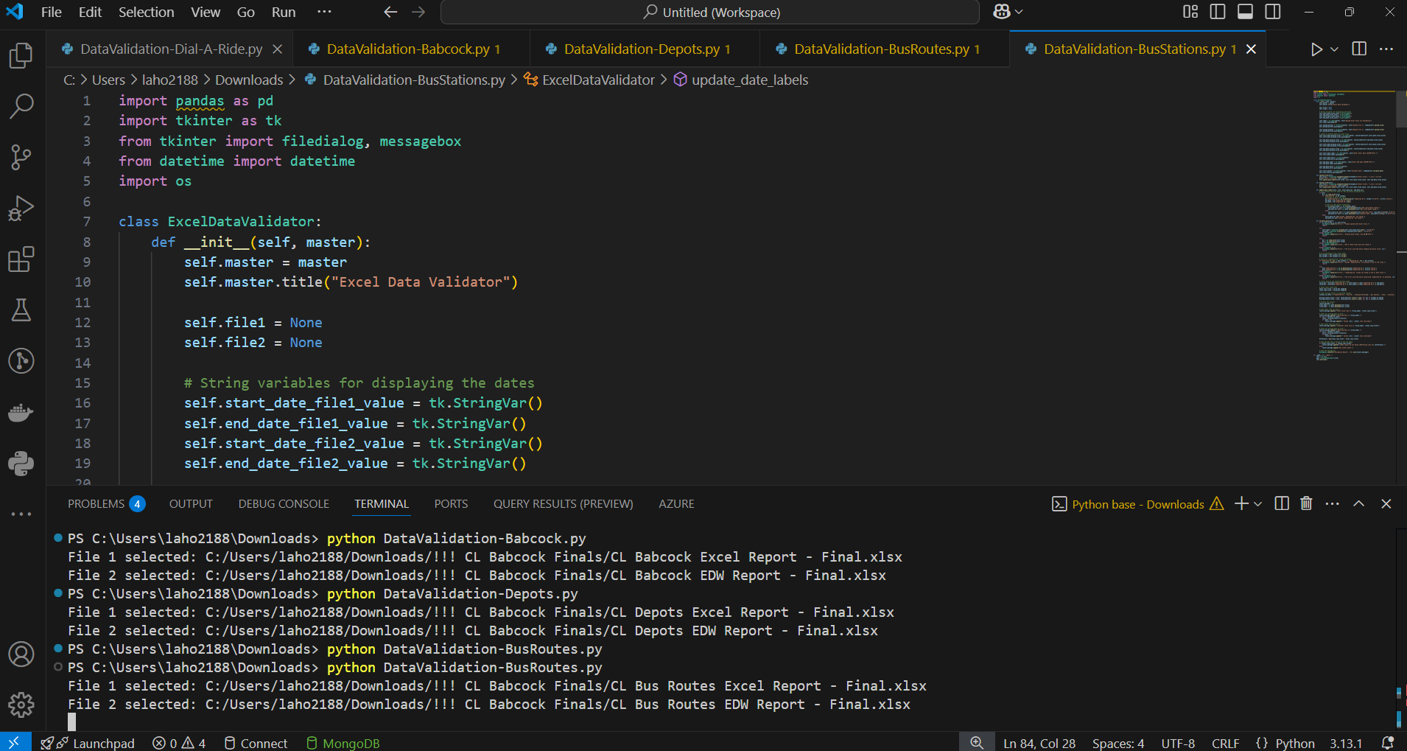
Data Validation Application
Project Overview
Tools & Environment
Programming Language:
Python
Development Environment:
Visual Studio Code
Libraries Used:
pandas – for data analysis
tkinter – for app interface
datetime – for dates
os – for file manipulations’

Slide 5
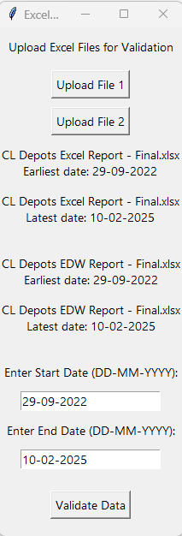
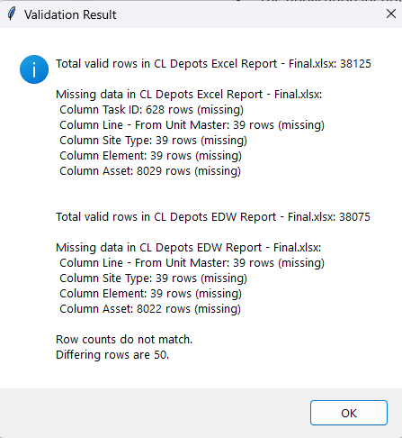
Data Validation Application
Project Overview
The Data Validation app - Key Features
File Upload and Comparison
Date Range Validation
3. User Interface for Validation &
Reporting
4. Row Count Check
5. Mandatory Fields/Columns Check
Column Name Consistency Check
The Difference Between Sources

Slide 6
Data Validation Application
Project Overview
Future developments
Possibility to add data from different sources (server/SQL and API) using user credentials
Generate detailed reports with the missing data from submissions and mandatory columns
Create a scheduled check and send a notification once a new issue is found

